Slide 1
Exciting things happen when involving young people to promote better research for better healthcare
Dpharm Europe – 9-10th February 2016
Jenny Preston: Patient and Public Involvement and Engagement Lead, NIHR Clinical Research Network
Simon Stones, Lucy Barker, Emily George: Patient Ambassadors
Notes:
Good afternoon, thank you for inviting us to talk this afternoon. We as a group are going to talk about exciting things happen when involving young people to promote better research for better healthcare.

Slide 2
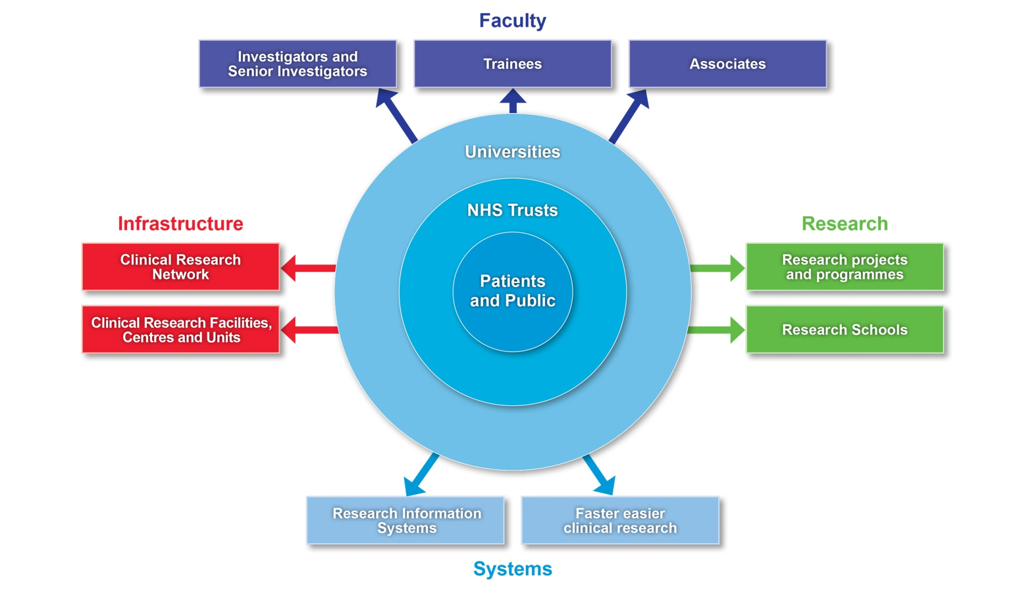
The NIHR health research system
Notes:
The NIHR is funded through the Department of Health to improve the health and wealth of the nation through research. The NIHR manages its health research activities through 4 main strands: Research, Systems, Infrastructure and Faculty. At the very heart of the system is patients and the public as without their support and involvement new and better treatments would not become available.

Slide 3
NIHR research
is pioneering
More than 200 patents have been granted, and over 300 licensing deals have been conducted since 2008
is practical
Over 250 pieces of NICE guidance are supported by NIHR research
is patient-focused
The NIHR standard application form demands clear explanations of how patients and members of the public have been involved in the research design and how they will be involved in the conduct of the study.
Notes:
NIHR Research is:
Pioneering etc etc

Slide 4
NIHR puts patients at the heart
“People-focused research in the NHS simply cannot be delivered without the involvement of patients and the public. No matter how complicated the research or how brilliant the researcher, patients and the public always offer unique, invaluable insight.”
Professor Dame Sally C Davies FRS, FMS Chief Medical Officer and Chief Scientific Adviser, Department of Health
Over 1,000 members of the public
were involved in 2013/14 on NIHR’s expert advisory groups reviewing funding applications and advising on research priorities.
3 million patients recruited
into NIHR studies since 2008, accessing leading edge treatments and best care.
Notes:
As already mentioned the NIHR places patients at the very heart of its work:
In 2013-2014 over 1,000 members of the public (read off slide)

Slide 5
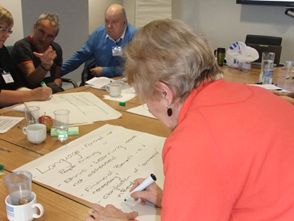
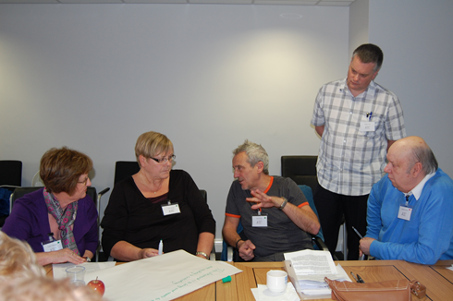
Patient & Public Involvement in Research
Involving patients, carers and the public, who have personal experience of or an interest in a health condition(s), in research or research related activities
An active partnership between patients and the public and researchers, doctors and other NHS staff
Notes:
By patient involvement in research we mean:

Slide 6
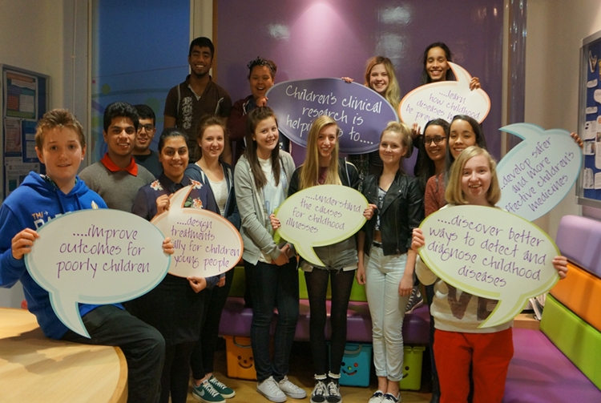
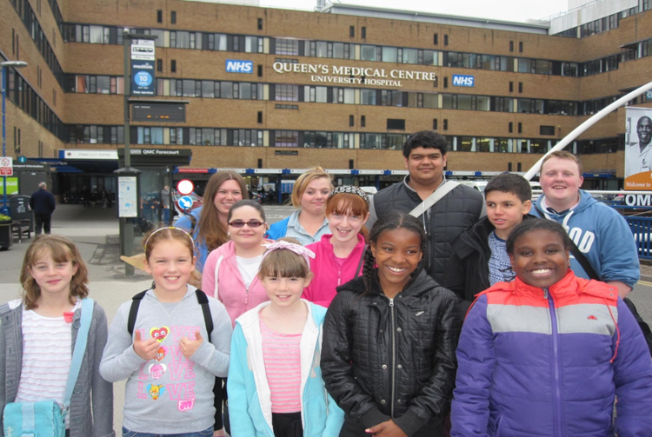
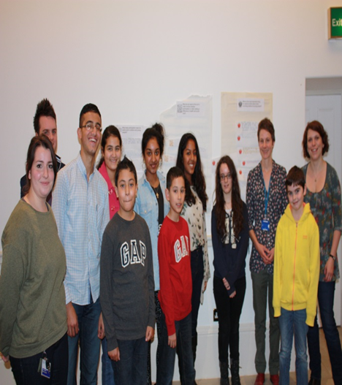
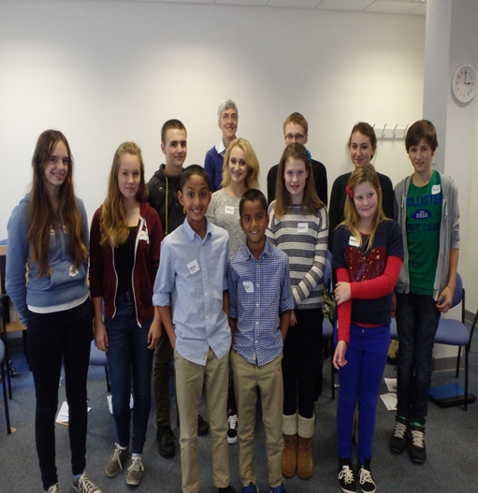
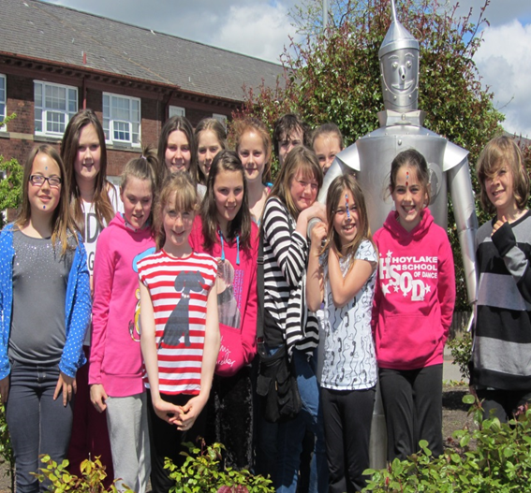
GenerationR YPAG
Notes:
In 2006, what was the NIHR Medicines for Children Research Network adopted a collaborative approach to the involvement of young people by setting up its first Young Persons’ Advisory Group based at the Network’s coordinating centre in Liverpool, now called GenerationR (R for research). Since then, four more groups have been established in London, Nottingham, Birmingham and Bristol. Each group has approximately 15-20 members aged between 8 and 19 years old. The purpose of the group is to engage young people with research and to work in partnership with, and offer support to, researchers. The group provides a forum for young people to learn about, and comment on, various aspects of the research cycle from the identification of research questions to the dissemination of research findings.

Slide 7
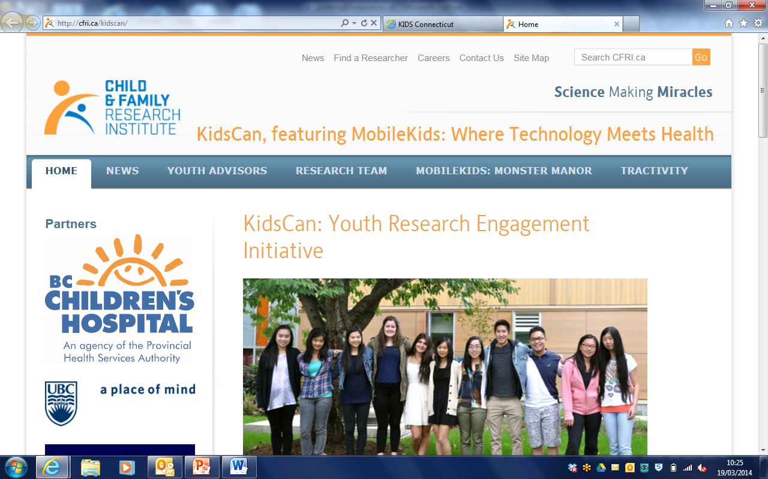
International collaborations
Notes:
The model developed here in the UK has influenced other groups across the world to develop and work together to provide a collective voice for children and young people.
I am now going to hand you over to Lucy, Emily and Simon who are young patient ambassadors for paediatric research:

Slide 8
Role of the groups
Learn about health/clinical research in monthly meetings
support and work in partnership with researchers in the delivery of health research
provide input and collaborate with key organisations such as National Research Ethics Service (NRES), Royal College Paediatrics Child Health (RCPCH), NIHR Clinical Research Facilities (CRFs), R&D within Hospitals, Academic Health Science Networks (AHSNs) to promote the research agenda and more importantly the involvement and engagement of young people in their processes

Slide 9
How the group helps researchers
Notes:
We talk and advise researchers on whether their study sounds good and practical for children and young people
We help them with their information sheets
We sometimes reassure them that it is a good study and not to be afraid of asking families to help

Slide 10
What’s important to young people

Slide 11
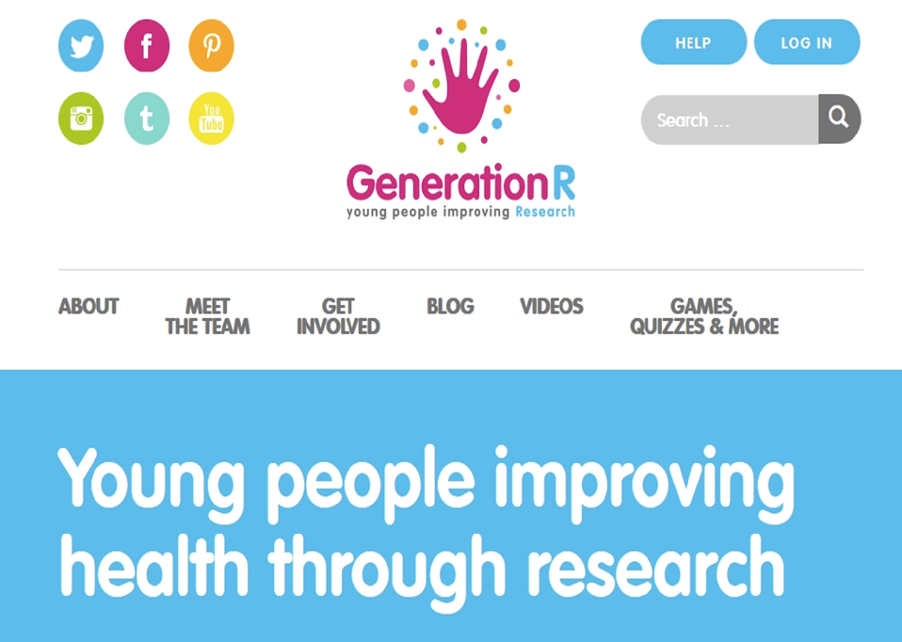

Slide 12
Living with JIA
Juvenile
Before the age of 16
Idiopathic
Of unknown etiology
Arthritis
One or more joints inflamed (i.e. swollen, painful, stiff, red, hot)

Slide 13
Discovering research
NIHR CRN: Children / Arthritis Research UK Paediatric Rheumatology Clinical Studies Group
Consumer representative – bringing the young person’s voice ’to the table’
Time and energy commitment
Understanding of the condition
Patients are real people, just like academics and health professionals
They are ’experts’ in their conditions

Slide 14
CRN Children Growth of Portfolio
*Total Number of Studies with CRN: Children as Main or Supporting Speciality = 969 as of 22nd January 2015

Slide 15
Paediatric Rheumatology Portfolio

Slide 16
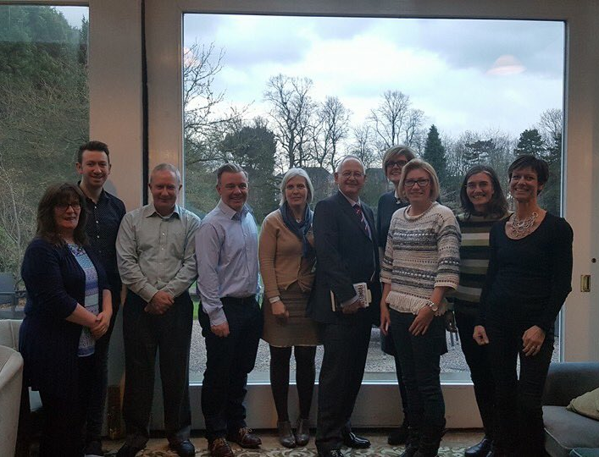
Values for involving the public in research
Respect
Support
Transparency
Responsiveness
Diversity
Accountability

Slide 17
Why must young people be involved?
“People who are affected by research have a right to have a say in what and how publicly funded research is undertaken”
“As healthcare professionals and academics, we must not assume we know more than anyone else….we should recognise that other people are experts and accept that other people have skills that will make your project work”
Research quality and relevance
Making research more relevant – it is everyone’s business
Policy drivers – Going the extra mile

Slide 18
When should young people be involved?

Slide 19
The importance of involving young people
Opportunities for young people to engage and become involved in research must be visible, and built upon collaborative relationships between the public, healthcare services, academia and industry
The experience of young people is a fundamental and valued source of knowledge
Person-centric initiatives (including young people) are most likely to lead to future sustainability and profitability for industry
BUT…
There are few robust, published models that explain how to implement and integrate young people as equal stakeholders
ABPI and National Voices have co-produced a detailed guidance document, which is intended to support pharmaceutical companies, patient organisations and health charities to collaborate together

Slide 20
My role as a patient research ambassador
Anyone who is passionate about involving patients and their families in research
Participation
Engagement
Involvement
@NIHR_PRAI
#PRAs

Slide 21
What have I achieved by being involved?
Co-applicant/co-investigator on 8 projects
Co-Principal Investigator on 1 project
Speaker at local, national and international conferences
Co-author of peer-reviewed publications
Winner of Public Engagement Award
Affiliated with around 20 different organisations as a patient research ambassador
UK youth representative at a European level
Inspired to have a career in research

Slide 22
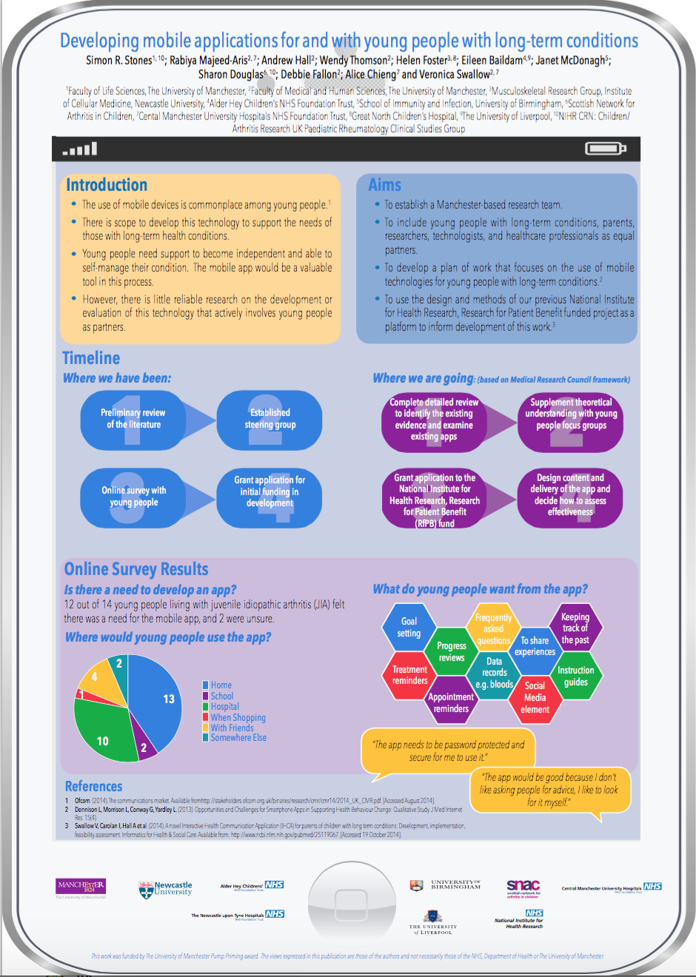
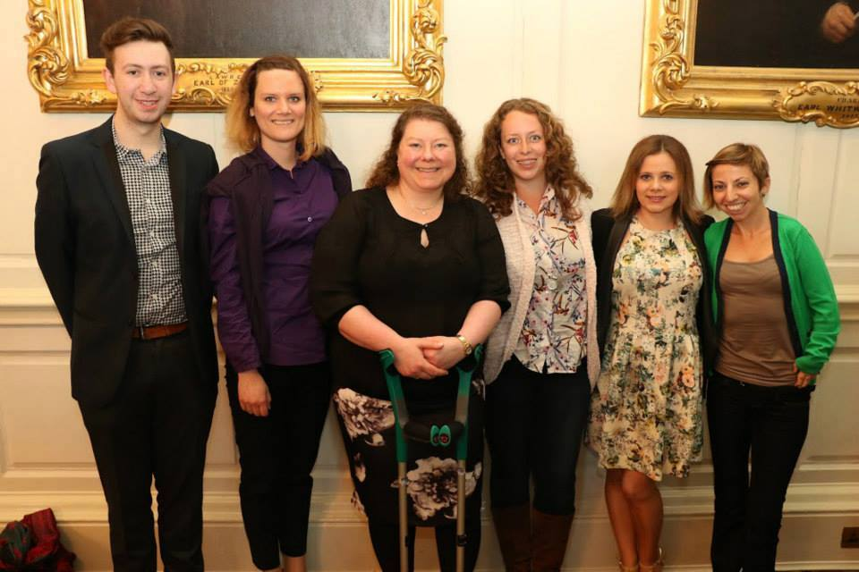
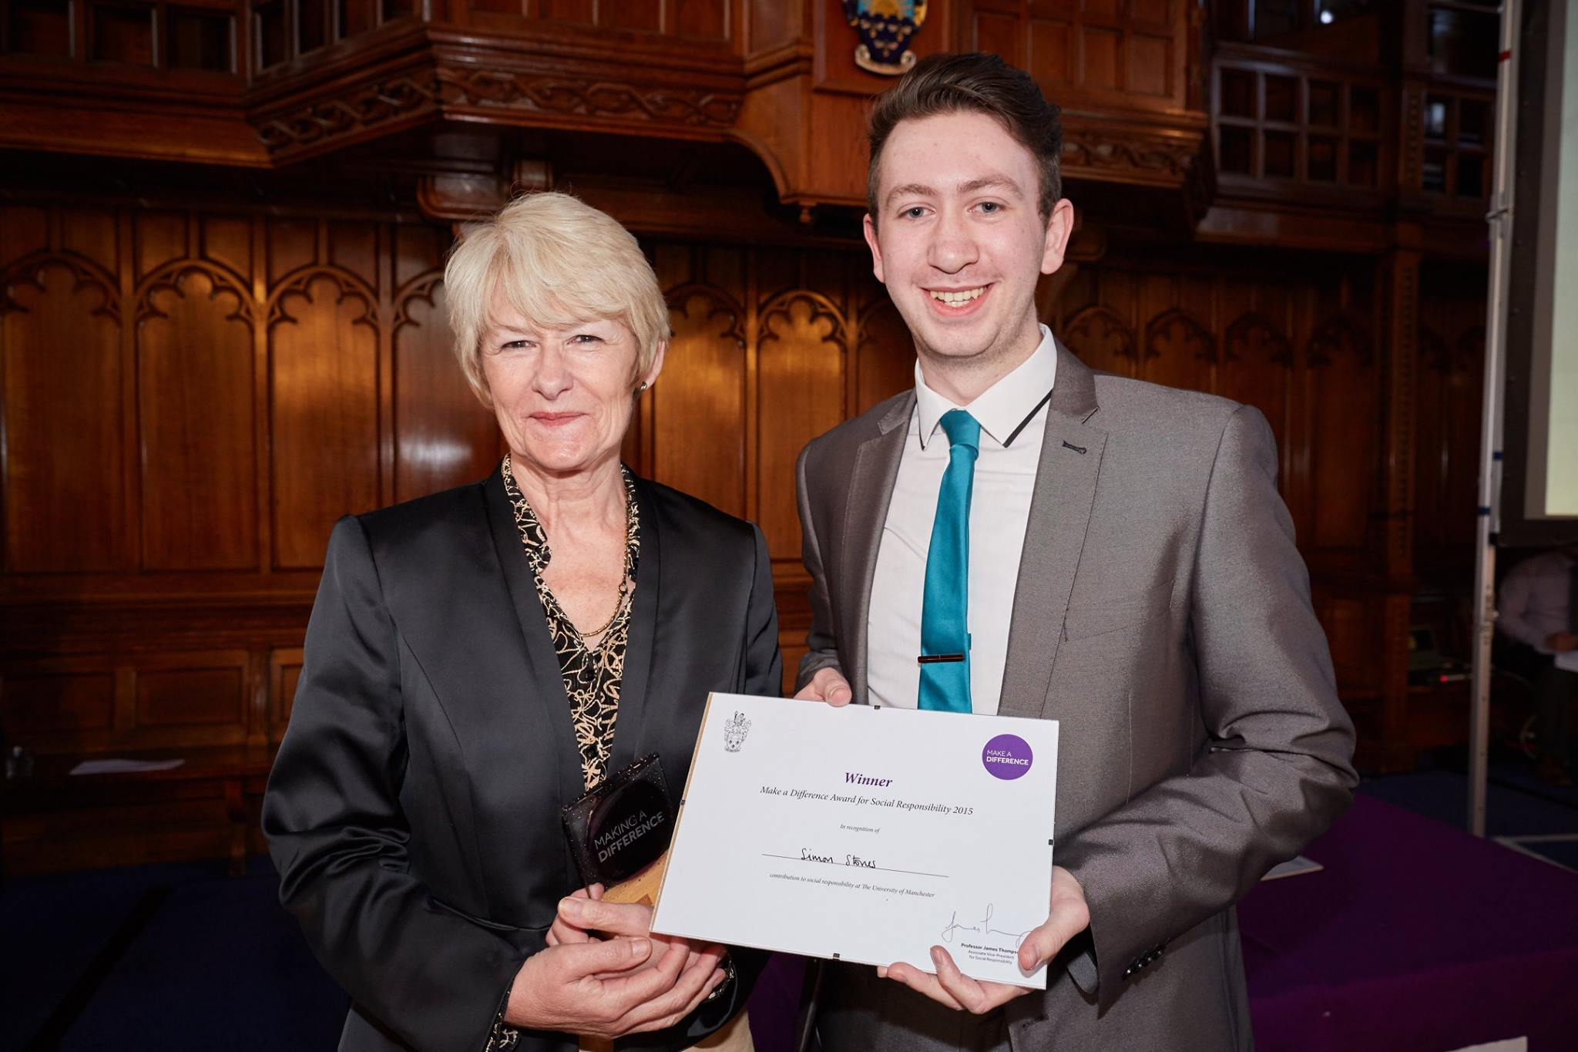
What have I achieved by being involved?

Slide 23
Feedback from researchers
“This is a particularly valuable resource for any researchers involving young people.. I was not aware of the groups existence prior to recommendations by the research ethics committee, I will certainly hope to seek their support in future studies”
“The groups opinions where instrumental in ensuring that the study outcomes were valid, important and meaningful for young people and parents themselves”

Slide 24
Jenny Preston
NIHR Clinical Research Network Patient and Public Involvement & Engagement Priority (PPIE) Lead & PPI Manager for Alder Hey Clinical Research Facility (CRF)
Jennifer.preston@nihr.ac.uk
Jennifer.preston@liverpool.ac.uk
GenerationR website
www.generationr.ac.uk
@GenrYPAGs
@EATC4Kids
@NIHR_PRAI

